Slide 1
Macromolecule Review

Slide 2
Where would you look for glycogen?
a. steak
b. potato
c. milkshake
d. cauliflower
Why?
Which foods above could be a source of protein?
Why?
If you cooked the steak too much, what could happen to the molecules in it?
How/why does that happen?

Slide 3
A steroid has
a. four fused rings
b. three fused rings
c. two fused rings
d. depends on the steroid
How can that steroid be altered to serve many functions?
What makes that steroid hydrophobic?
If you add a hydroxyl group (OH) to the steroid does it become more or less polar?

Slide 4
Plants store most of their energy for later use as
a. unsaturated fats
b. sucrose
c. starch
d. cellulose
Which of the above is not a sugar?
How do you know?
How are starch and cellulose related?
Which one is harder to break down and why?
What do starch and fats have in common?
Explain how a person would gain fat by eating too many carbohydrates.

Slide 5
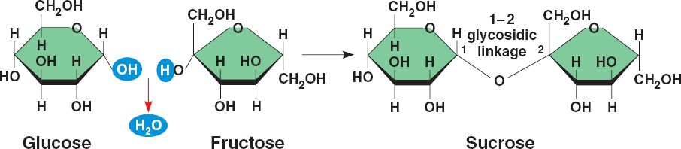
What type of reaction is below?
What type of bond is formed? See box 1
What type of carbohydrate is created?
How are glucose and fructose related?
What type of sugar is fructose?
Is this an alpha or beta glucose molecule?
What type of reaction could break the sucrose apart?
1

Slide 6
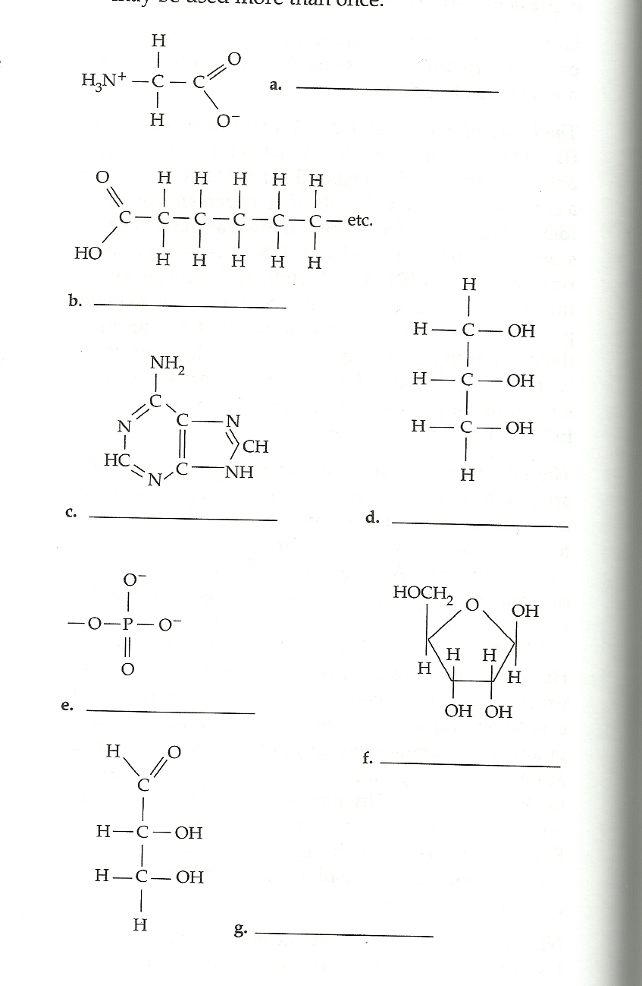
Match the molecule to
the description
Molecules that would combine to form a fat
Attached to other monomers by a peptide bond
Carbohydrate
Purine
Protein monomer
Combine to form nucleotide
Most nonpolar
Joined by phosphodiester bonds
A B
C D
E F
G

Slide 7
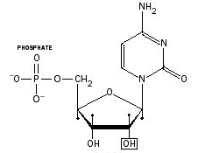
What is this molecule?
What macromolecule does it form?
Is this an RNA or DNA base? How do you know?
Would you consider the base a purine or pyrimidine? Why?
How many bases exist in nucleic acids?
Which one exists in DNA but not RNA?

